Slide 1

Static and default routing configuration Final lab evaluation
Presented by
Rikit gupta – 2020a1r176 Sahil kumar – 2020a1r180
Rishi mehra – 2020a1r175 Aryadev singh – 2020a1r195

Slide 2

Topics
Static routing
Default routing
Configuration of both static and default routing
Networking devices(hub, switches..)

Slide 3
Static routing
static routing is a type of network routing technique. Static routing is not a routing protocol; instead, it is the manual configuration and selection of a network route, usually managed by the network administrator. It is employed in scenarios where the network parameters and environment are expected to remain constant

Slide 4

Implementation of static router

Slide 5
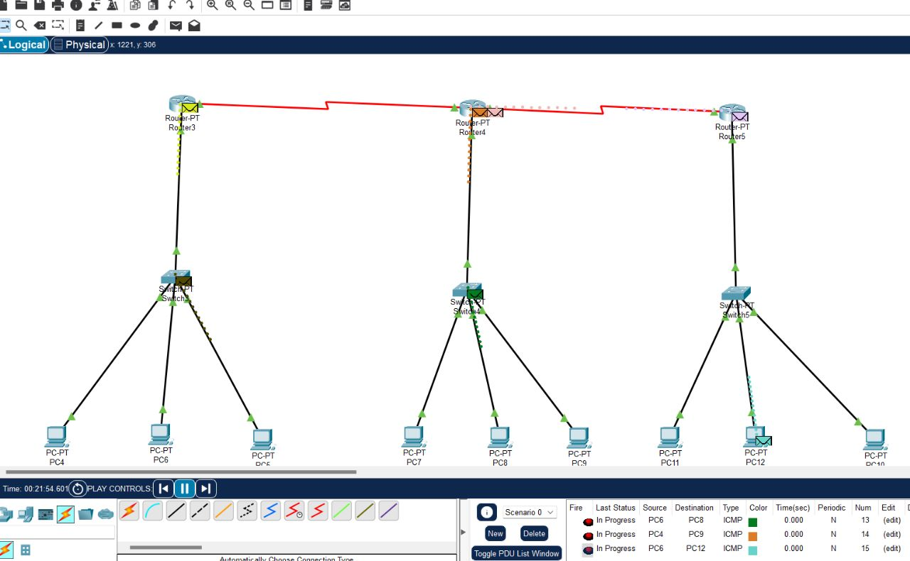

Slide 6
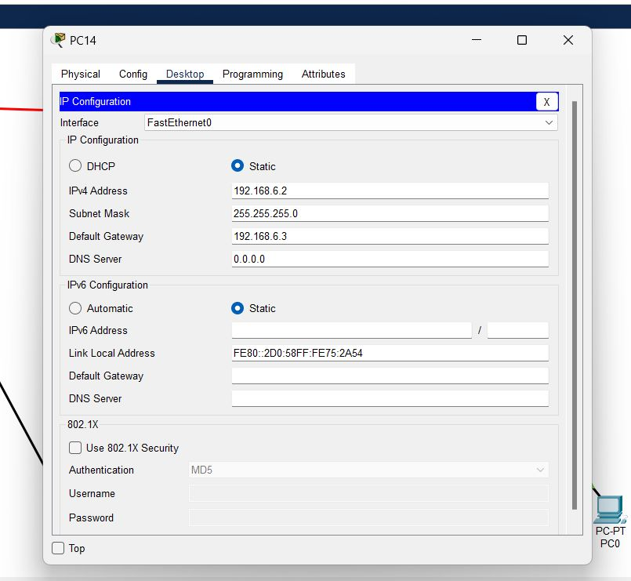
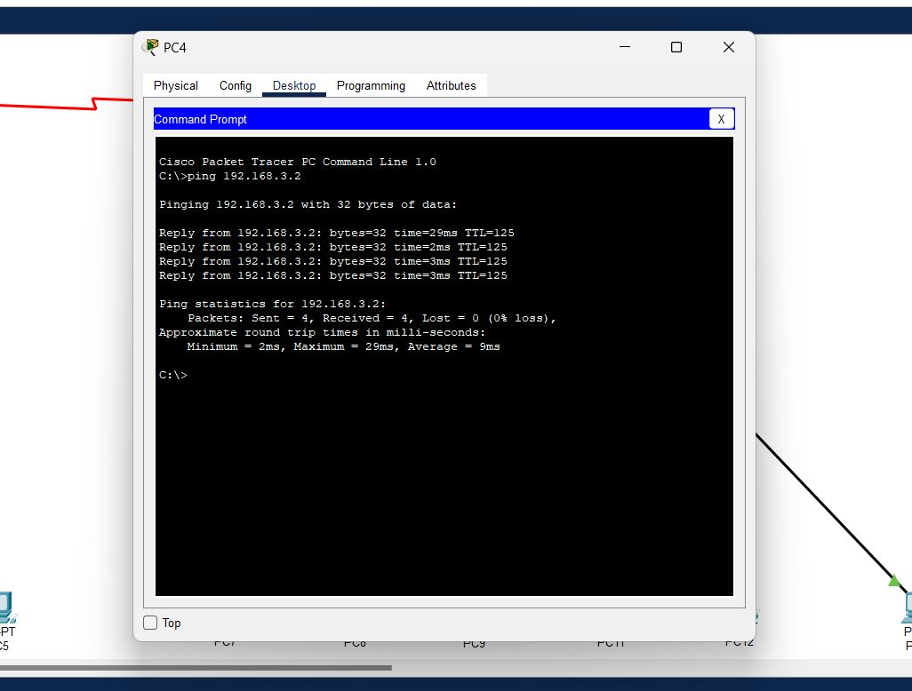

Slide 7
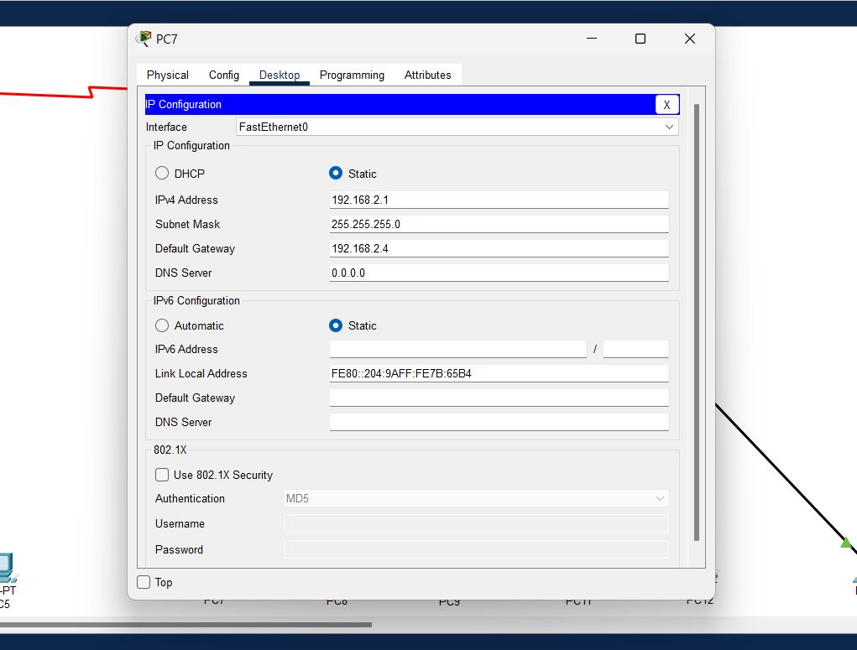
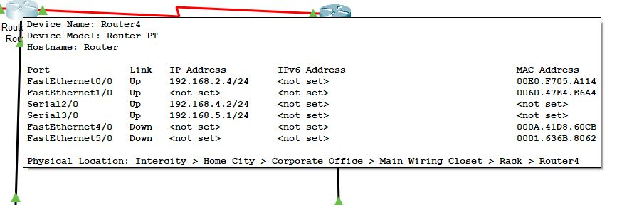

Slide 8
Default router
A default route is a route that takes effect when no other route is available for an IP destination address.
If a packet is received on a routing device, the device first checks to see if the IP destination address is on one of the device’s local subnets. The device checks its routing table if the destination address is not local. If the remote destination subnet is not listed in the routing table, the packet is forwarded to the next hop toward the destination using the default route. The default route generally has a next-hop address of another routing device, which performs the same process. The process repeats until a packet is delivered to the destination.

Slide 9
Implementation of default router

Slide 10
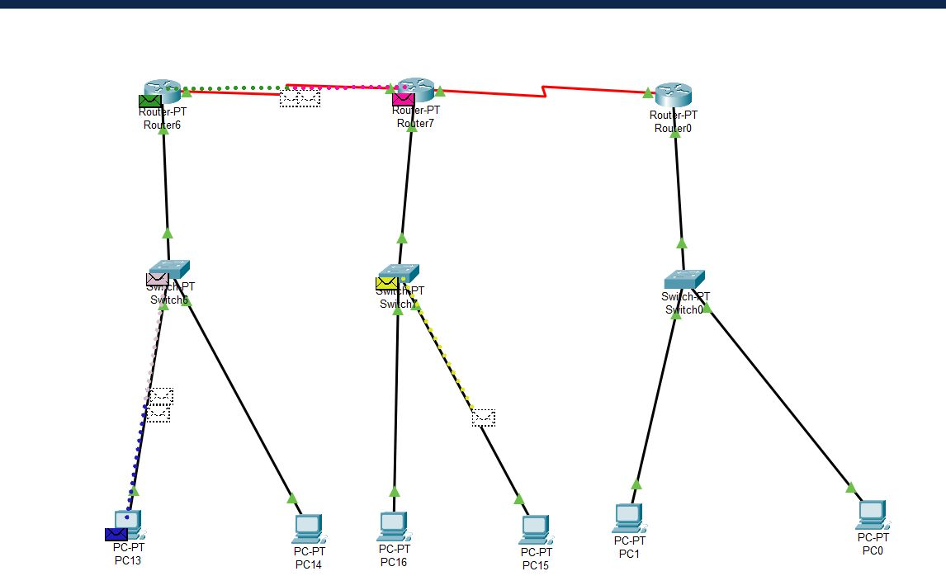

Slide 11
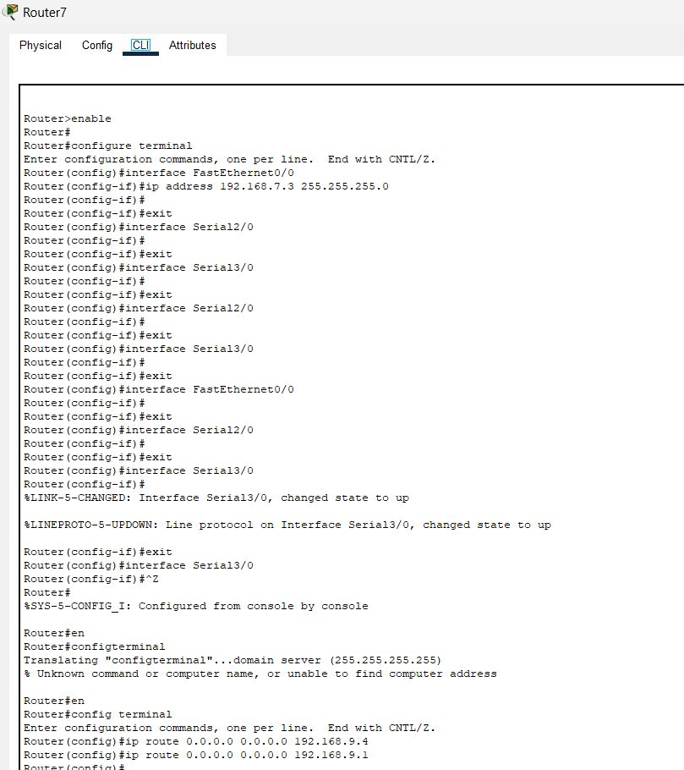

Slide 12

Thank you

